Slide 1

6th Grade Accelerated Math
Unit 13, Lesson 1 Evaluating Expressions Volume 2, pg. 263

Slide 2


Benchmark
MA.6.AR.1.3
Evaluate algebraic expressions using substitution and order of operations.
volume 2, pg. 263

Slide 3
Integrated Mathematical Thinking and Reasoning Standards
MA.K12.MTR.4.1 Engage in discussions that reflect on the mathematical thinking of self and others.
MA.K12.MTR.5.1 Use patterns and structure to help understand and connect mathematical concepts.
volume 2, pg. 263

Slide 4

Learning Targets
I can apply order of operations to an algebraic expression.
I can evaluate expressions that include exponents.
volume 2, pg. 263

Slide 5

Warm-Up
volume 2, pg. 263

Slide 6
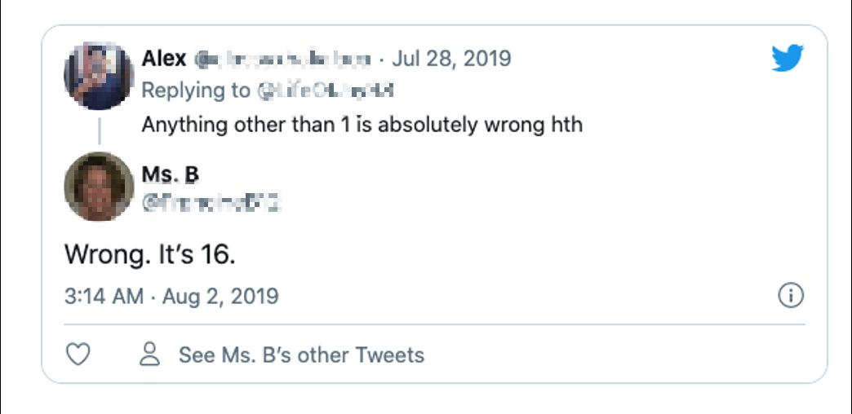

13.1.1 Warm-Up: Evaluating Numeric Expressions
This math expression is dividing the internet.
What is the value of $8÷2(2+2)$?
volume 2, pg. 263

Slide 7

Do you agree with Alex or Ms. B? Explain or show why using order of operations.
Find the value of the expression. Show your work.
$$4−2×6÷3+7$$
volume 2, pg. 263

Slide 8

Guided Instruction
volume 2, pg. 264

Slide 9
13.1.2 Guided Instruction: Applying Order of Operations to Algebraic Expressions
Recall from 5th grade that an order of operations is used to evaluate numeric expressions with multiple operations. Grouping symbols such as parentheses are used to indicate which operations should be performed first. The following order is used.
Step 1: Perform operations within grouping symbols.
Step 2: Evaluate exponents.
Step 3: Multiply and divide in order from left to right (→).
Step 4: Add and subtract in order from left to right (→).
volume 2, pg. 264

Slide 10
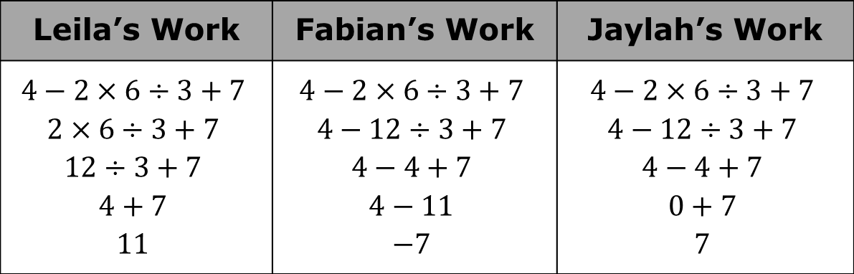
Three students completed the warm-up. The steps in each student’s process are shown.
Leila’s Work | Fabian’s Work | Jaylah’s Work
$$4−2×6÷3+7$$ $$2×6÷3+7$$ $$12÷3+7$$ $$4+7$$ $$11$$ | $$4−2×6÷3+7$$ $$4−12÷3+7$$ $$4−4+7$$ $$4−11$$ $$−7$$ | $$4−2×6÷3+7$$ $$4−12÷3+7$$ $$4−4+7$$ $$0+7$$ $$7$$
volume 2, pg. 264

Slide 11
Complete the statements about which student correctly applied the given steps of the order of operations.
evaluated the numerical expression correctly. She first performed all in order from left to right and then performed all in order from left to right.
Leila
Fabian
Jaylah
multiplication and division
addition and subtraction
multiplication and division
addition and subtraction
volume 2, pg. 264

Slide 12
With your partner, discuss the work of each student, Leila, Fabian, and Jaylah. Two of these students made a mistake somewhere. Circle the mistakes that you and your partner found.
volume 2, pg. 264

Slide 13

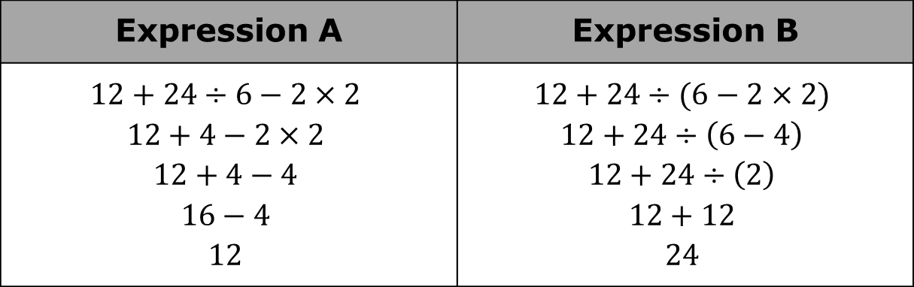
Omari evaluated Expression A and Expression B. His work is shown.
With your partner, discuss the two original expressions that Omari evaluated and his corresponding answers.
Omari’s partner gave him a on both of his answers. Why did Omari arrive at two different values when evaluating these expressions?
Expression A | Expression B
$$12+24÷6−2×2$$ $$12+4−2×2$$ $$12+4−4$$ $$16−4$$ $$12$$ | $$12+24÷(6−2×2)$$ $$12+24÷\left(6−4\right)$$ $$12+24÷\left(2\right)$$ $$12+12$$ $$24$$
volume 2, pg. 264

Slide 14
Like numeric expressions, algebraic expressions can be evaluated using order of operations when given a specific value for the variable(s).
In an algebraic expression, a variable is a letter that represents a number. It is called a variable because the value used to replace the letter can vary.
volume 2, pg. 264

Slide 15

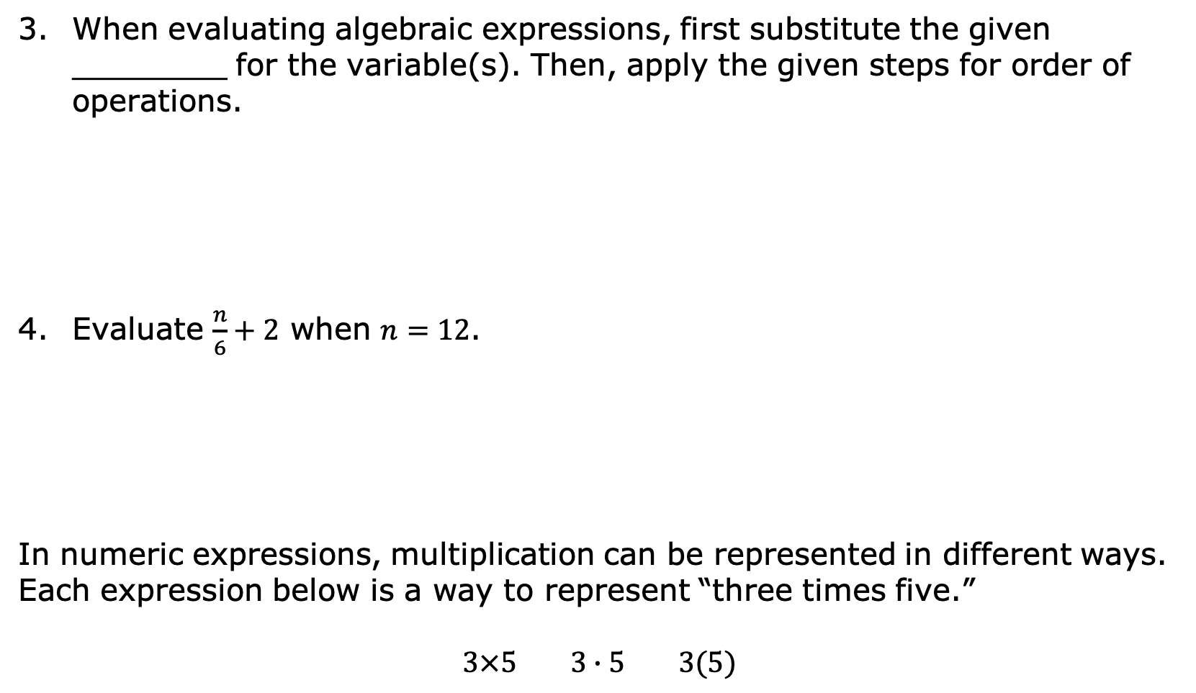
When evaluating algebraic expressions, first substitute the given ________ for the variable(s). Then, apply the given steps for order of operations.
Evaluate $\frac{n}{6}+2$ when $n=12$.
In numeric expressions, multiplication can be represented in different ways. Each expression below is a way to represent “three times five.”
$3×5$ $3∙5$ $3(5)$
In mathematics, evaluate is an instruction that indicates the answer is a value.
volume 2, pg. 265

Slide 16
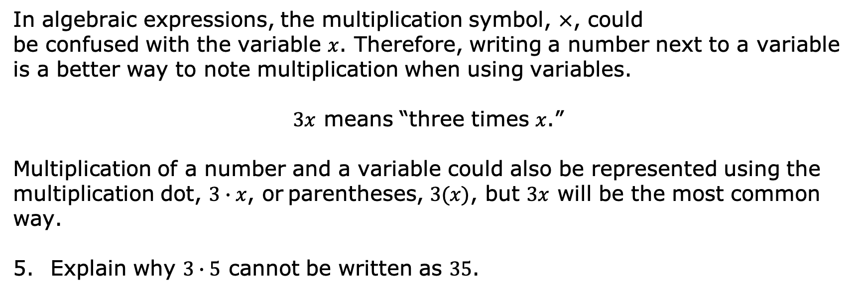
In algebraic expressions, the multiplication symbol, ×, could be confused with the variable $x$. Therefore, writing a number next to a variable is a better way to note multiplication when using variables.
$3x$ means “three times $x$.”
Multiplication of a number and a variable could also be represented using the multiplication dot, $3∙x$, or parentheses, $3(x)$, but $3x$ will be the most common way.
Explain why $3∙5$ cannot be written as $35$.
volume 2, pg. 265

Slide 17


What is the value of $3x$ if $x=5$?
Find the value of $7m−(3+b−12)÷2$ if $m=4$ and $b=15$. Show your work.
When substituting values into algebraic expressions, it is helpful to put the substituted value in parentheses when the variable is being multiplied by a known value.
volume 2, pg. 265

Slide 18

Collaboration
volume 2, pg. 266

Slide 19


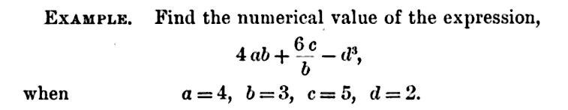
13.1.3 Collaboration: Order of Operations
The problem below is an example from First Year Algebra.
An order of operations was first noted in First Year Algebra by Webster Wells and Walter Wilson Hart. The textbook was published in 1912.
volume 2, pg. 266

Slide 20
What is the numerical value of the expression? Show your work.
Check your work with your partner.
volume 2, pg. 266

Slide 21

The work shown in the textbook is below.
What is the difference between your work and the work from the book?
volume 2, pg. 266

Slide 22
An order of operations became more important when programmers needed a set of rules to program a computer to find values of numeric expressions. In 1883, Ada Lovelace described in her book about Charles Babbage's analytical engine, the first computer, that codes could be created so the device could handle letters and symbols along with numbers.
volume 2, pg. 266

Slide 23
Guided Instruction
volume 2, pg. 267

Slide 24
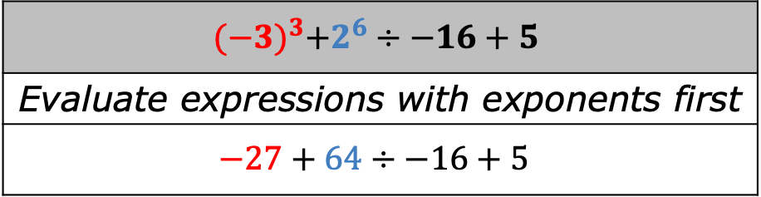
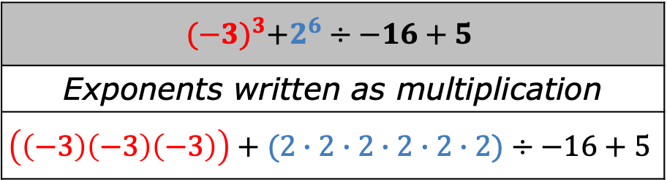

13.1.4 Guided Instruction: Evaluating Expressions with Exponents
The work in the book, First Year Algebra, showed $2^{3}$ written out as multiplication. This method can get complex as shown in the table.
$${(−3)}^{3}+2^{6}÷−16+5$$
Exponents written as multiplication
$$\left(\left(−3\right)\left(−3\right)\left(−3\right)\right)+(2∙2∙2∙2∙2∙2)÷−16+5$$
$${(−3)}^{3}+2^{6}÷−16+5$$
Evaluate expressions with exponents first
$$−27+64÷−16+5$$
volume 2, pg. 267

Slide 25
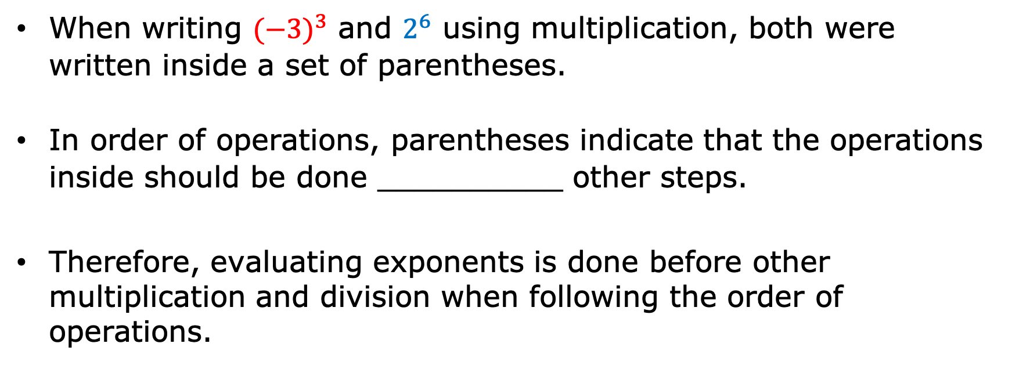
When writing ${(−3)}^{3}$ and $2^{6}$ using multiplication, both were written inside a set of parentheses.
In order of operations, parentheses indicate that the operations inside should be done __________ other steps.
Therefore, evaluating exponents is done before other multiplication and division when following the order of operations.
volume 2, pg. 267

Slide 26
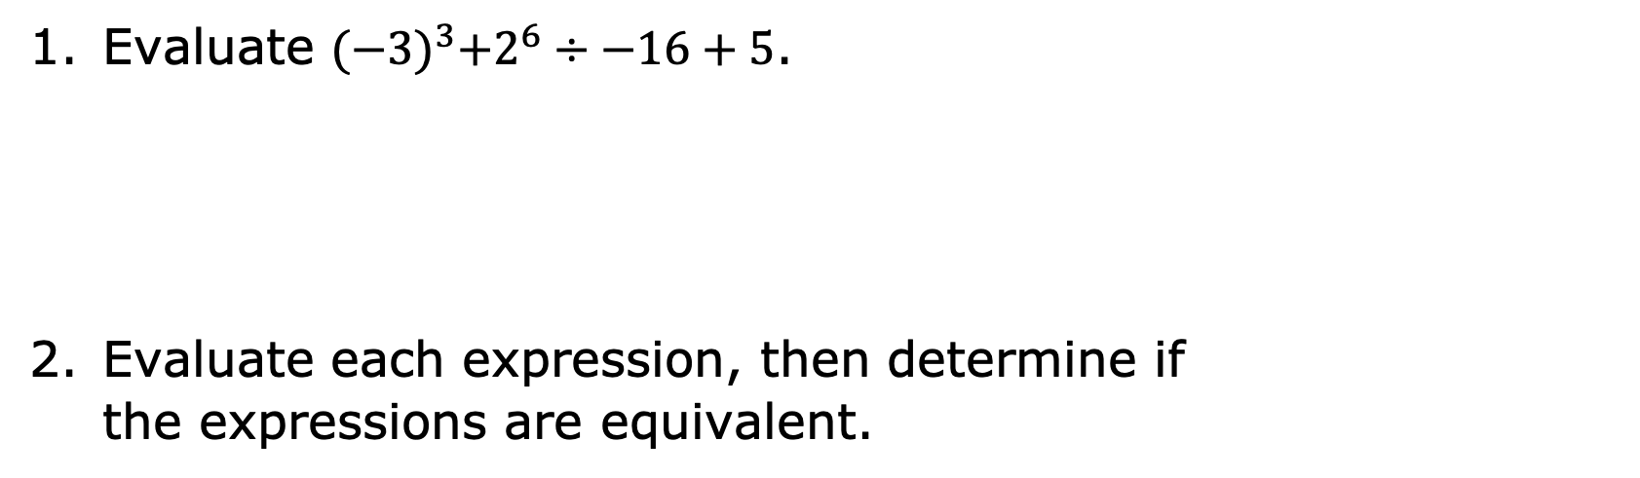
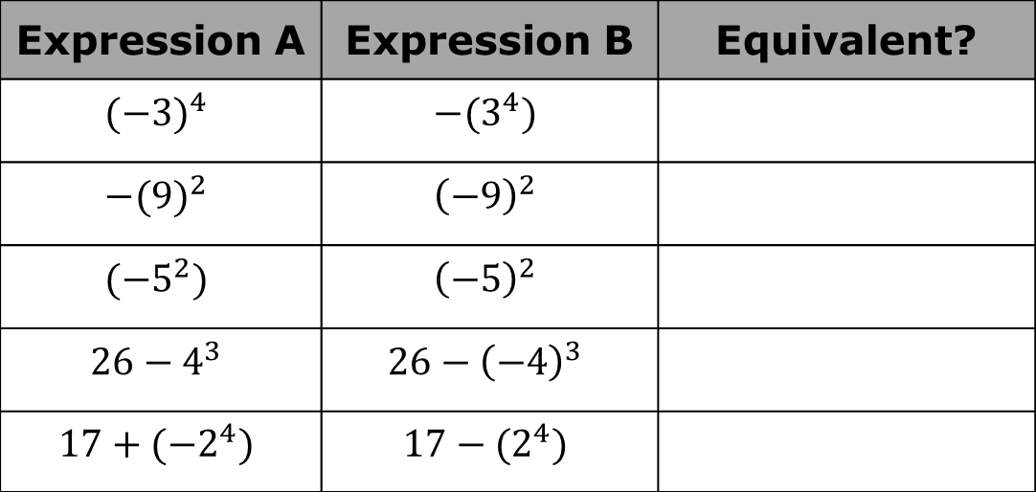
Evaluate ${(−3)}^{3}+2^{6}÷−16+5$.
Evaluate each expression, then determine if the expressions are equivalent.
Expression A | Expression B | Equivalent?
$${(−3)}^{4}$$ | $$−{(3}^{4})$$
$${−(9)}^{2}$$ | $${\left(−9\right)}^{2}$$
$${(−5}^{2})$$ | $${\left(−5\right)}^{2}$$
$$26−4^{3}$$ | $$26−{\left(−4\right)}^{3}$$
$$17+{(−2}^{4})$$ | $$17−{(2}^{4})$$
volume 2, pg. 267

Slide 27
Describe a strategy that can be used when evaluating expressions with exponents that include a negative sign or a subtraction sign.
volume 2, pg. 267

Slide 28
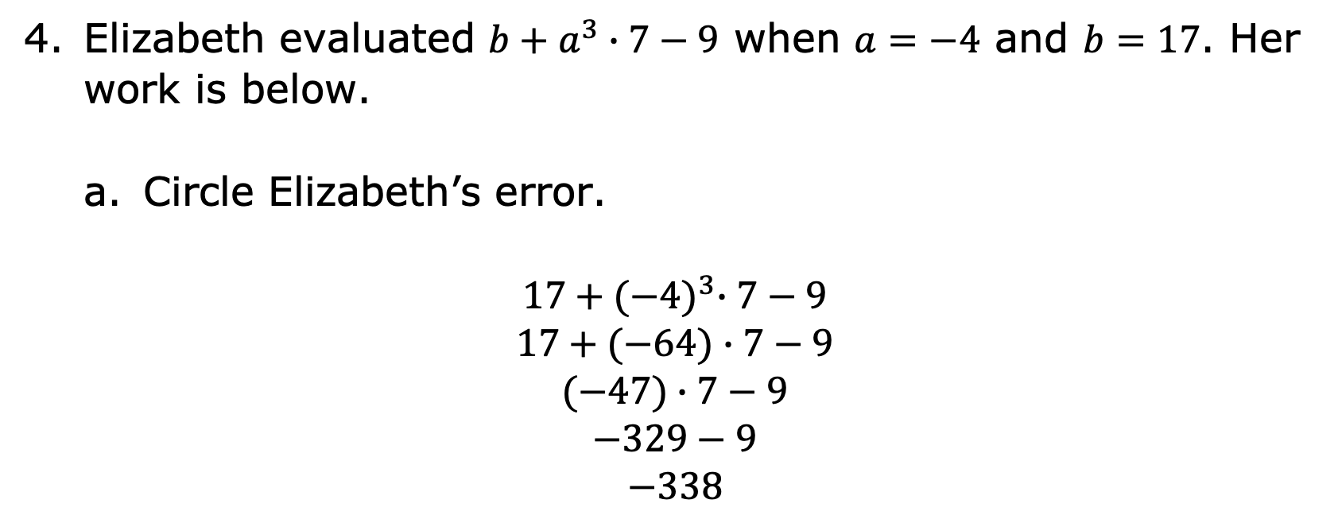
Elizabeth evaluated $b+a^{3}∙7−9$ when $a=−4$ and $b=17$. Her work is below.
Circle Elizabeth’s error.
$$17+{(−4)}^{3}∙7−9$$
$$17+(−64)∙7−9$$
$$(−47)∙7−9$$
$$−329−9$$
$$−338$$
volume 2, pg. 268

Slide 29
Which step of the order of operations did she not apply correctly?
Evaluate expressions with exponents.
Perform operations inside grouping symbols.
Perform multiplication and division in order from left to right.
Perform addition and subtraction in order from left to right.
volume 2, pg. 268

Slide 30

The order of performing computations is to first work within grouping symbols using the order of operations. Then, simplify terms with exponents. Next, while reading from left to right, perform multiplication and division in the order in which it appears. Finally, while reading from left to right, perform addition and subtraction in the order in which it appears.
volume 2, pg. 268

Slide 31

Try It
volume 2, pg. 268

Slide 32

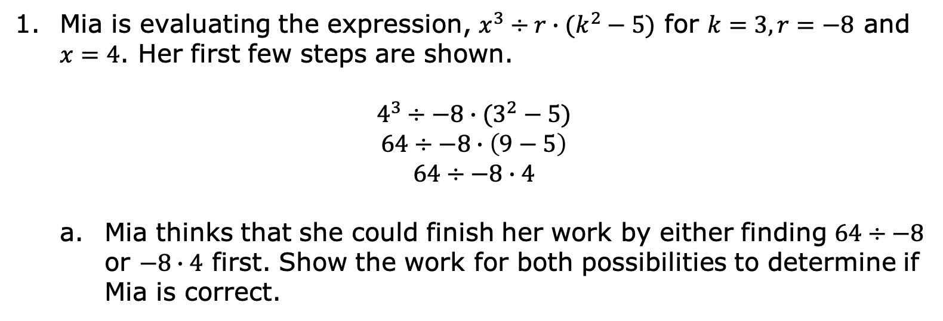
13.1.5 Try It: Discovering the Importance of Left to Right
Mia is evaluating the expression, $x^{3}÷r∙(k^{2}−5)$ for $k=3, r=−8$ and $x=4$. Her first few steps are shown.
$$4^{3}÷−8∙(3^{2}−5)$$
$$64÷−8∙\left(9−5\right)$$
$$64÷−8∙4$$
Mia thinks that she could finish her work by either finding $64÷−8$ or $−8∙4$ first. Show the work for both possibilities to determine if Mia is correct.
volume 2, pg. 268

Slide 33
Was Mia correct when she stated that both methods would work? Use the steps of the order of operations to justify whether or not Mia is correct.
volume 2, pg. 268

Slide 34
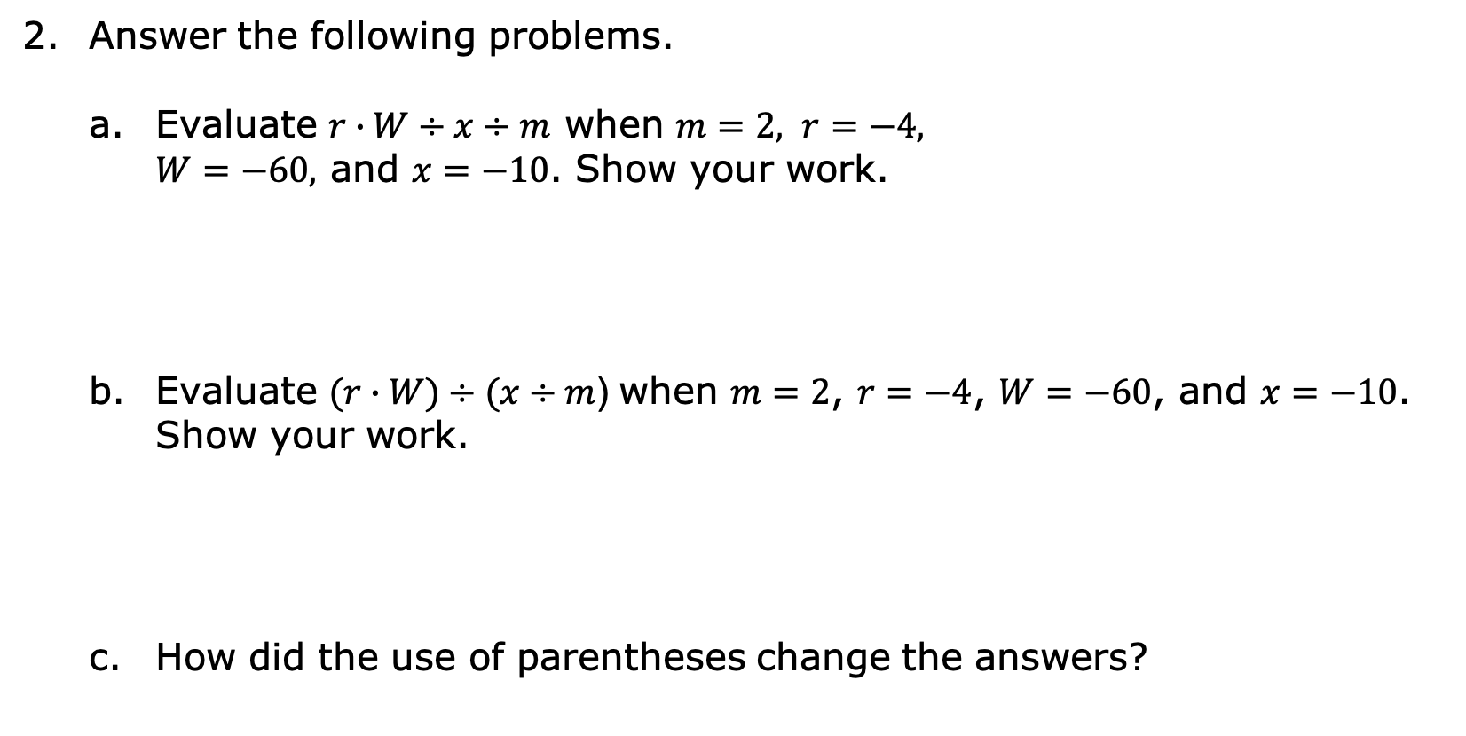
Answer the following problems.
Evaluate $r∙W÷x÷m$ when $m=2, r=−4,$ $W=−60,$ and $x=−10$. Show your work.
Evaluate $(r∙W)÷(x÷m$) when $m=2$, $r=−4$, $W=−60$, and $x=−10$. Show your work.
How did the use of parentheses change the answers?
volume 2, pg. 269

Slide 35

Wrap-Up
volume 2, pg. 269

Slide 36
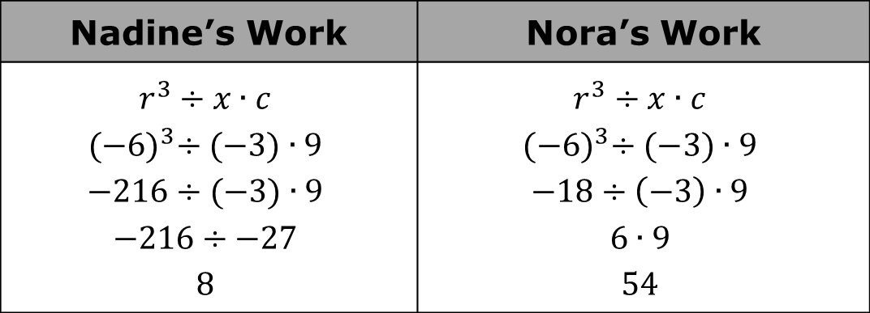
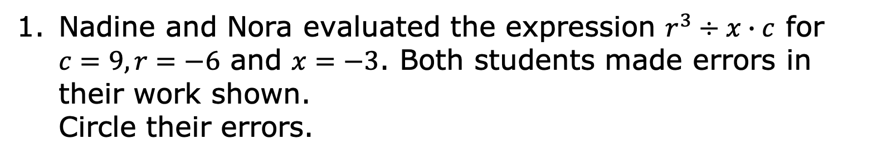
13.1.6 Wrap-Up: Error Analysis
Nadine and Nora evaluated the expression $r^{3}÷x∙c$ for $c=9, r=−6$ and $x=−3$. Both students made errors in their work shown. Circle their errors.
Nadine’s Work | Nora’s Work
$$r^{3}÷x∙c$$ $${(−6)}^{3}÷(−3)∙9$$ $$−216÷(−3)∙9$$ $$−216÷−27$$ $$8$$ | $$r^{3}÷x∙c$$ $${(−6)}^{3}÷(−3)∙9$$ $$−18÷\left(−3\right)∙9$$ $$6∙9$$ $$54$$
volume 2, pg. 269

Slide 37
Write a short explanation to each student to explain the mistake and what she needs to remember about evaluating expressions in the future.
To Nadine: | To Nora:
volume 2, pg. 269

